Slide 1


Azure Bank Modernization Initiative: Banking capstone project
Arshiya Shaik

Slide 2
Introduction and Business Goals

Slide 3

Project Objectives
End-to-end Azure-based banking data platform
Real-time + batch ingestion using Event Grid, Service Bus, ADLS
Azure Functions for validation, transformation, and orchestration
Cosmos DB operational store for low-latency access
Databricks (PySpark) for large-scale ETL using Medallion architecture
SQL Data Warehouse for analytics & reporting
Real-time fraud detection engine with rule-based logic
CI/CD automation for deployment using DevOps / GitHub Actions
Enterprise-grade security with Firewall, VNet isolation & Private Endpoints

Slide 4

Architecture Overview
Hybrid Lambda Architecture supporting real-time + batch pipelines
Event-driven ingestion using Event Grid, Service Bus & Azure Functions
Centralized storage using ADLS Gen2 (Raw → Bronze → Silver → Gold)
Distributed transformations using Databricks (PySpark)
Analytical warehouse built on Azure SQL / Synapse
Real-time fraud detection with rule-based engine

Slide 5
Hybrid Lambda Architecture
This diagram illustrates the hybrid architecture designed for real-time data processing and secure banking solutions.

Slide 6
Key Components
Understanding the essential architecture elements
Operational Data Store
Real-time Ingestion
The operational data store, powered by Cosmos DB, provides a robust repository for processed transactions, allowing instant availability of data for downstream applications and analytical needs.
Real-time ingestion utilizes Azure Event Grid and Azure Functions to process a continuous stream of transactions, enabling immediate updates and fraud detection capabilities for the banking system.
Batch Ingestion
Batch ingestion processes daily transactional files using Azure Data Lake Storage and PySpark, ensuring large volumes of historical data are integrated into the system efficiently and accurately.

Slide 7
Ingestion Layer
Overview of data ingestion processes
Batch Ingestion
Batch ingestion processes daily files from various sources, utilizing Azure Data Lake Storage (ADLS) for efficient storage and triggering analytical workflows for comprehensive data analysis.
Streaming Ingestion
Processing Layer
Streaming ingestion captures real-time transactions like ATM and mobile events through Event Grid, ensuring timely processing and immediate response to emerging data streams.
The processing layer utilizes Azure Functions to validate, classify, and detect suspicious patterns, ensuring that critical data is promptly stored in Cosmos DB for immediate accessibility.

Slide 8

Data Lake Architecture
Raw → Bronze → Silver → Gold

Slide 9
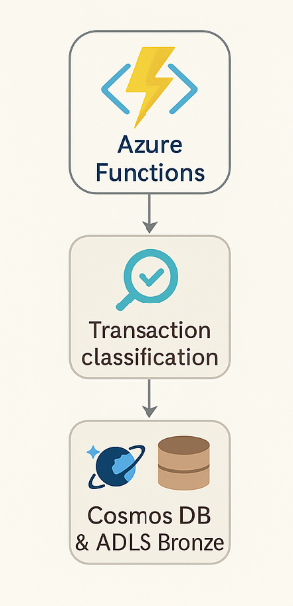
Processing Layer
Schema validation
Deduplication
Transaction classification
Suspicious pattern detection
Writing to Cosmos DB & ADLS Bronze

Slide 10
Operational Data Store (Cosmos DB)
Operational Data Store (Cosmos DB)
Stores cleaned and validated real-time ATM & UPI transactions
Provides low-latency read/write operations for downstream applications
Enables instant fraud detection and Customer 360 insights
Ensures high availability and global replication
Purpose
Fast lookups for fraud engine
Operational dashboards
API-driven applications
Real-time event analysis

Slide 11

Data Warehouse

Slide 12
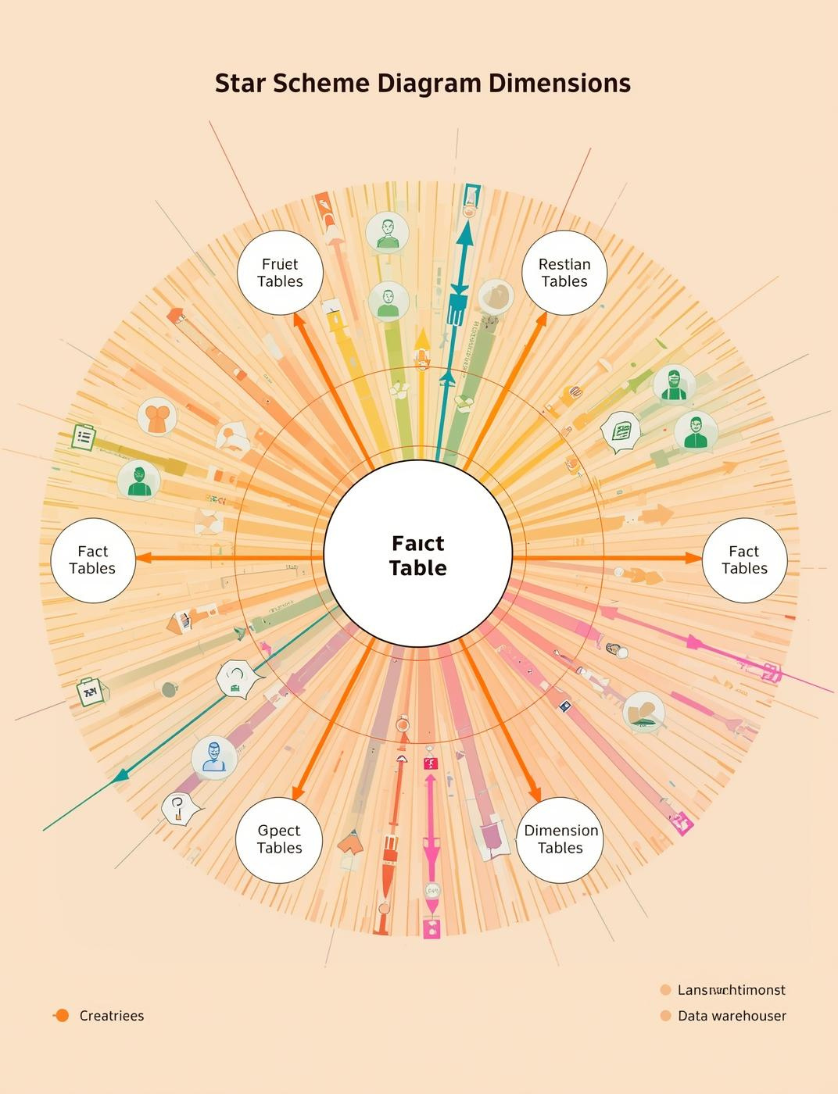
Star Schema Design
Dimension Tables
DimCustomer
DimAccount
DimProduct
DimBranch
DimDate
Fact Tables
FactTransactions
FactFraudEvents
FactCustomerActivity

Slide 13

Real-Time Fraud Detection
High-value transaction trigger
Velocity & anomaly checks
Alert stored in Cosmos DB
Notification via Service Bus

Slide 14

Fraud Detection Measures
01
High-Value Alerts
Transactions exceeding a predefined threshold trigger alerts, ensuring immediate review by the fraud detection system, allowing for rapid response to potential fraudulent activities.
02
Anomaly Checks
A robust rule engine analyzes transaction patterns, validating against historical data to identify anomalies, which prompts alerts and notifications to relevant stakeholders for further investigation.

Slide 15
Build Pipeline
Pull latest code from GitHub/Azure Repos
Validate Python Azure Function code
Package & prepare deployment artifacts
Run notebook validation for Databricks
Release Pipeline
Deploy Azure Functions using slot-based deployment
Upload/Sync Databricks notebooks via REST API
Execute SQL schema migrations (dimensions, facts)
Promote changes from Dev → QA → Production automatically
CI/CD Pipeline Automation

Slide 16

Secure Networking
Ensuring robust security and automated CI/CD are crucial for maintaining a resilient banking data platform and protecting sensitive data.

Slide 17

Key Platform Capabilities

Slide 18
Core Capabilities of the Platform
Challenges in Implementation and Solutions
Real-time data ingestion processes ensure immediate access.
Batch ingestion allows for large-scale data management.
Unified transaction history enhances customer insights.
Secure architecture maintains data integrity and compliance.
Integration of heterogeneous data sources presents complexities.
Low-latency fraud detection requires efficient processing.
Ensuring data quality across platforms is crucial.
Scalability to manage growing transaction volumes is essential.

Slide 19

The Azure Data Platform offers unmatched scalability, robust security measures, and seamless automation, enabling banks to efficiently manage data while ensuring compliance and enhancing customer experiences.

Slide 20

Conclusion and Next Steps
Modern banking platform
Real-time + batch processing
Automated, secure, scalable
Supports Customer 360 & fraud detection

Slide 21
Thank You

